Slide 1
Interplanetary and Planetary Explorer Mission Group 2
Forgione Vincenzo (828615)
Laus Andrea (920660)
Lazzoni Luca (917155)
de Miguel Alejandro (918897)

Slide 2
Introduction
Content:
Assignment 1: Interplanetary Explorer Mission
Introduction
Design process
Preliminary analysis
Optimization process
Final results
Conclusion and comments

Slide 3
Interplanetary mission: Introduction
Neptune
Uranus
Jupiter
Departure
Flyby
Arrival

Slide 4
Interplanetary mission: Introduction
Figure of merit
Principal: ∆V
Secondary: ∆T
Operational constraints
Reasonable mission time
Avoid collisions with other planets
Mission constraints
Planets of the mission are the furthest→ long distances and times.
Maximum time window = 70 years
Maximum time of flight = 35 years (not included in triple-loop approach)
Patched conics method
Maximum ∆V= 40 km/s

Slide 5
Interplanetary mission: Design process
A priori Hohmann transfer → ∆V = [1.5-2.5] km/s
Computational approaches
Triple-Loop
Genetic Algorithm
Pareto front

Slide 6
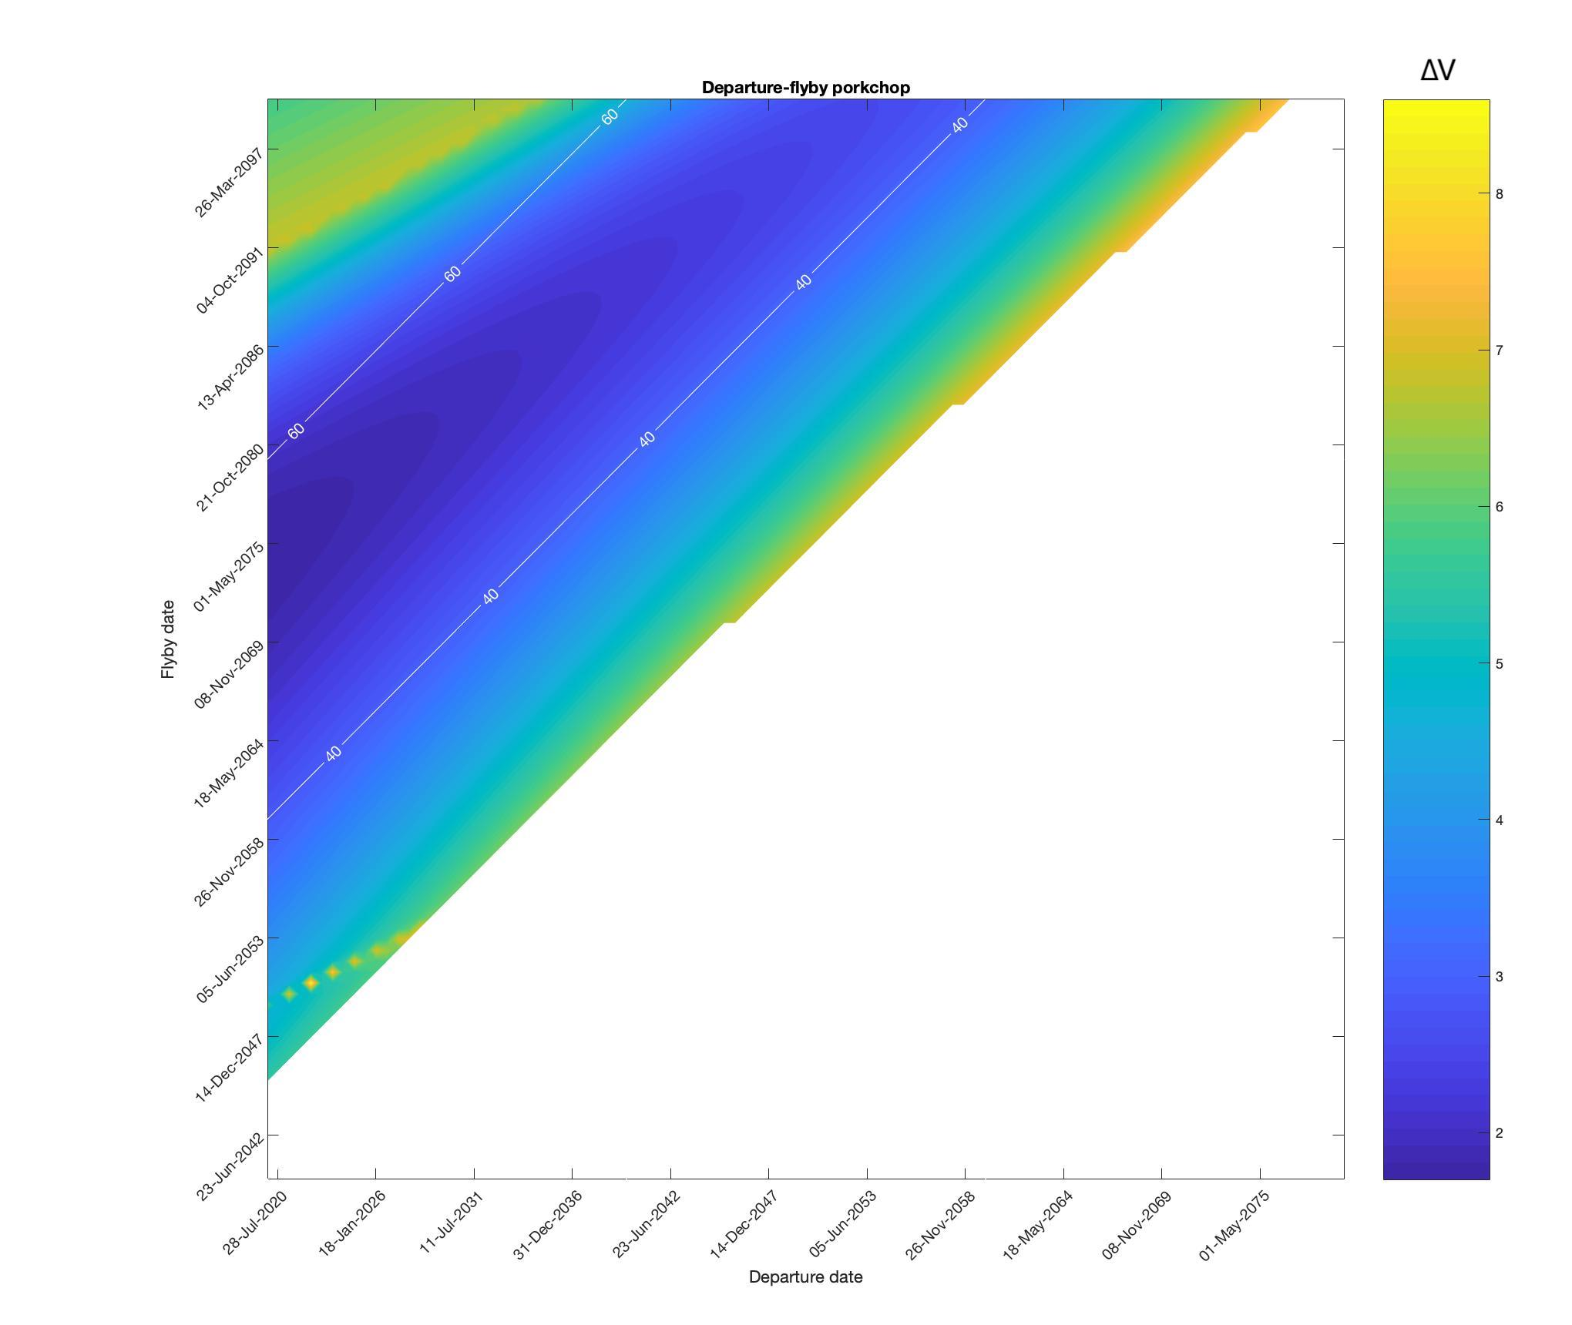
Interplanetary mission: Preliminary analysis

Slide 7
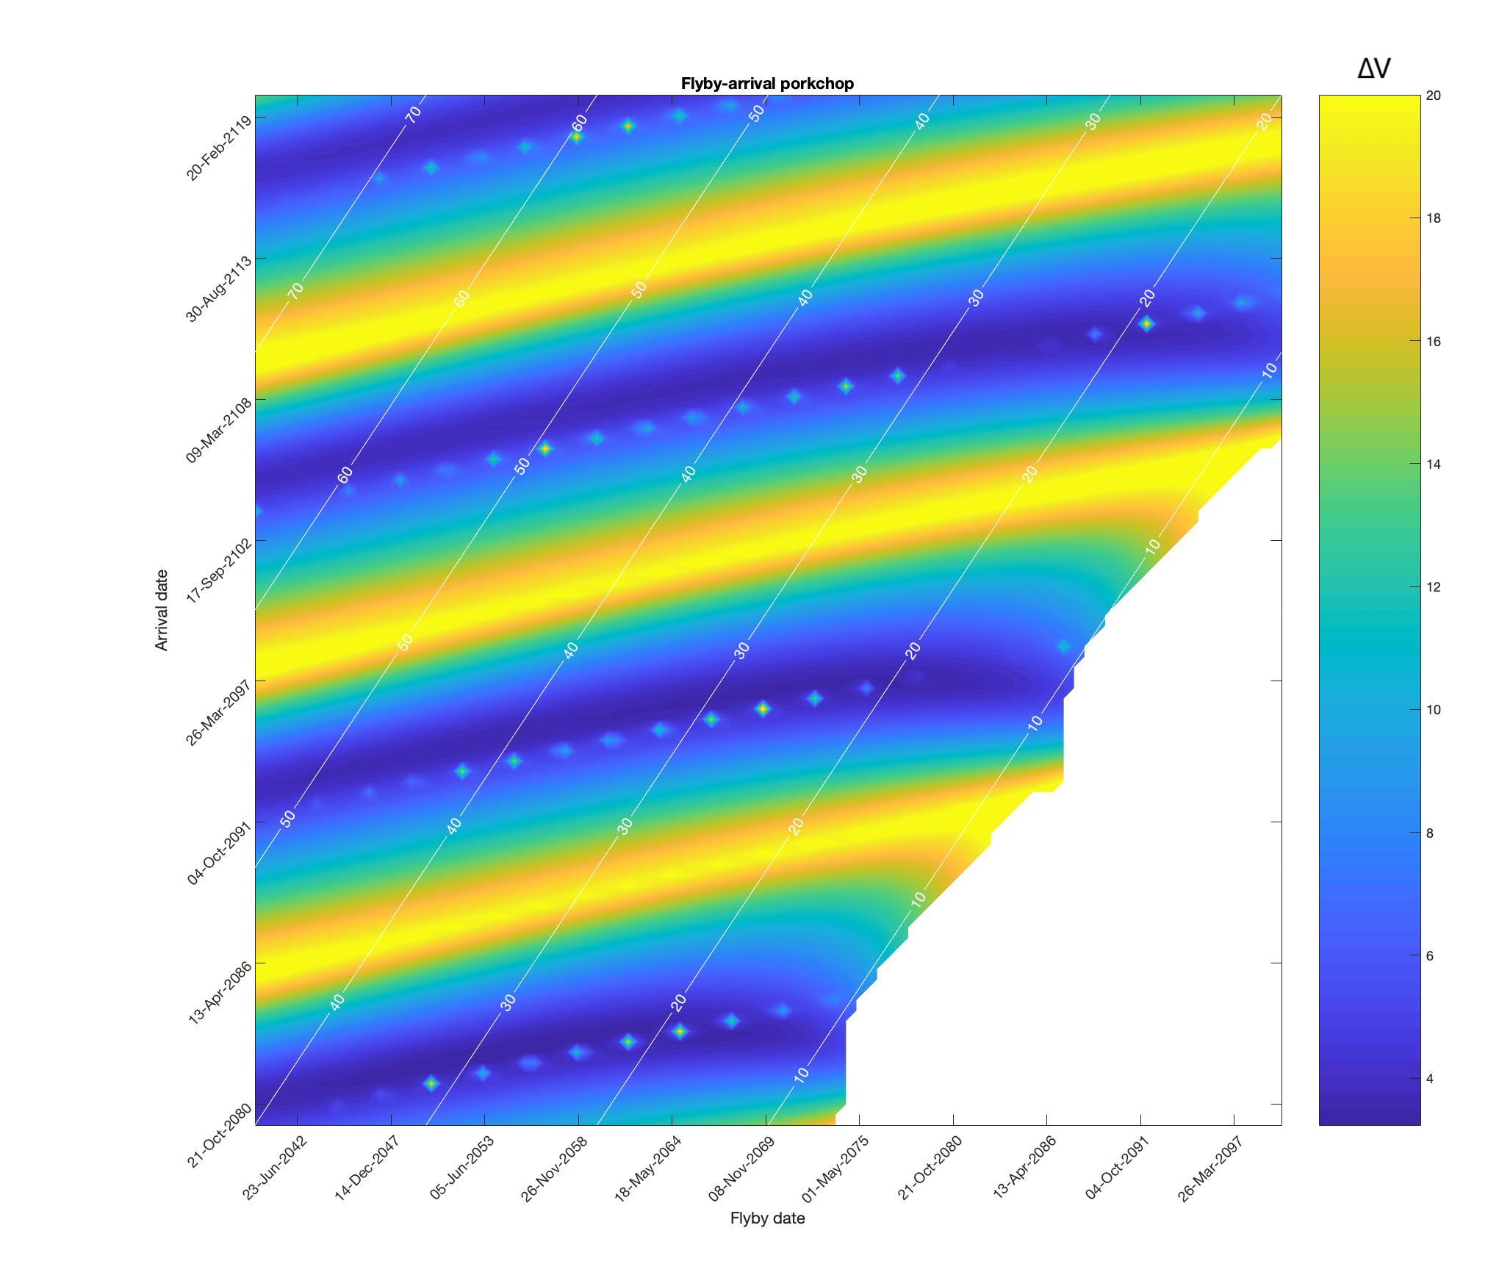
Interplanetary mission: Preliminary analysis

Slide 8
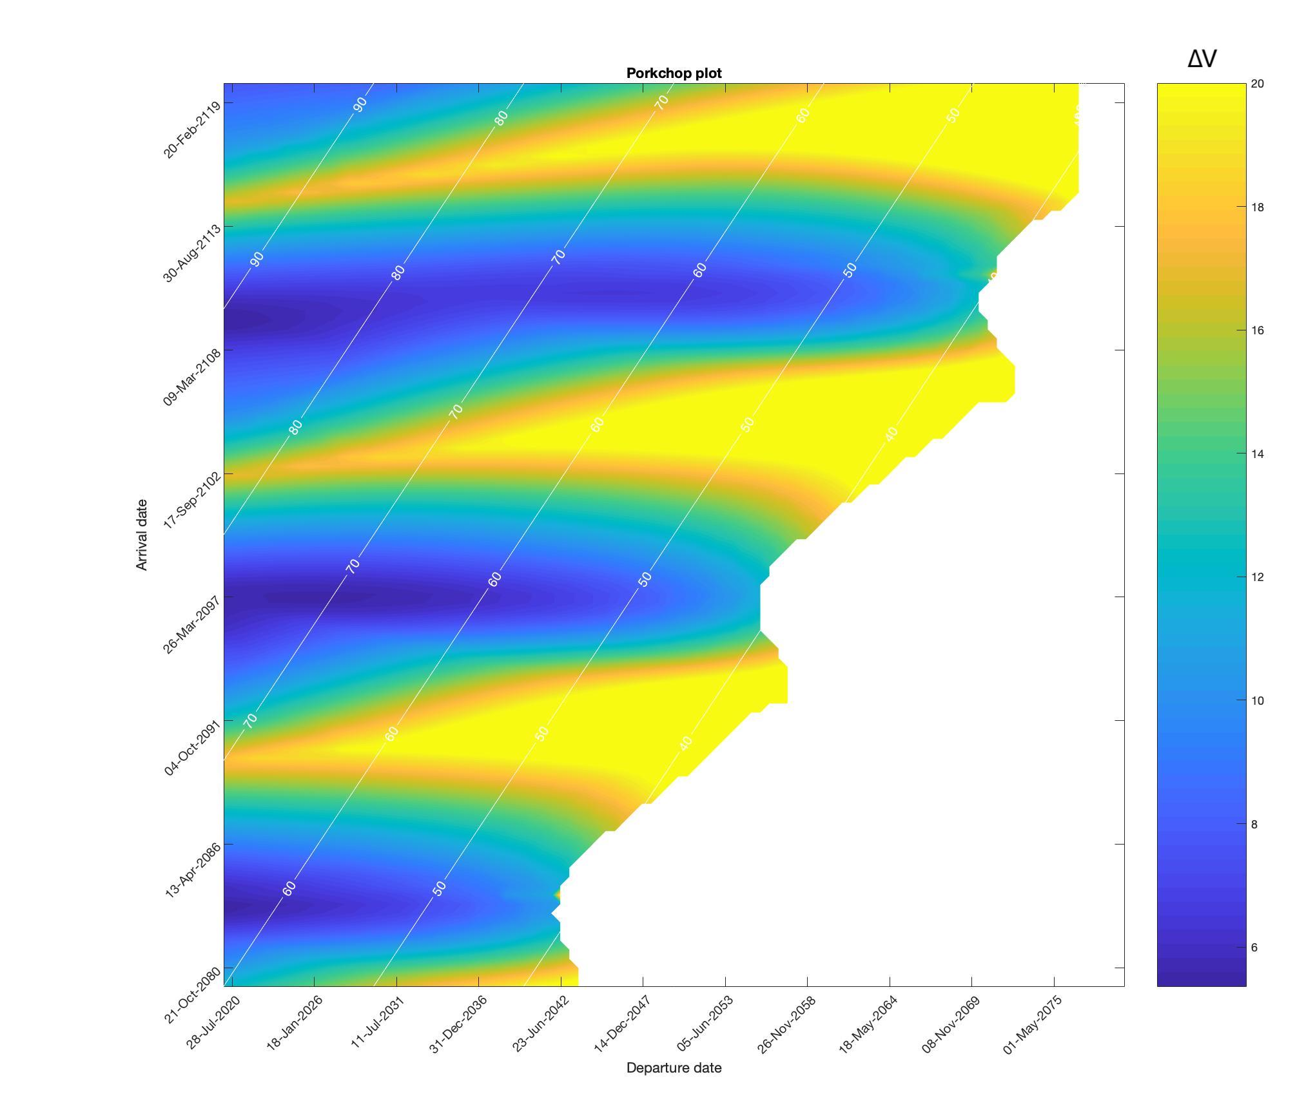
Interplanetary mission: Preliminary analysis

Slide 9
Interplanetary mission: Design process
Triple-Loop
Pork chop plot without constraints
Genetic algorithm
Min ∆V with constraints
Pareto front
Optimal trade-off ∆V and ∆T

Slide 10
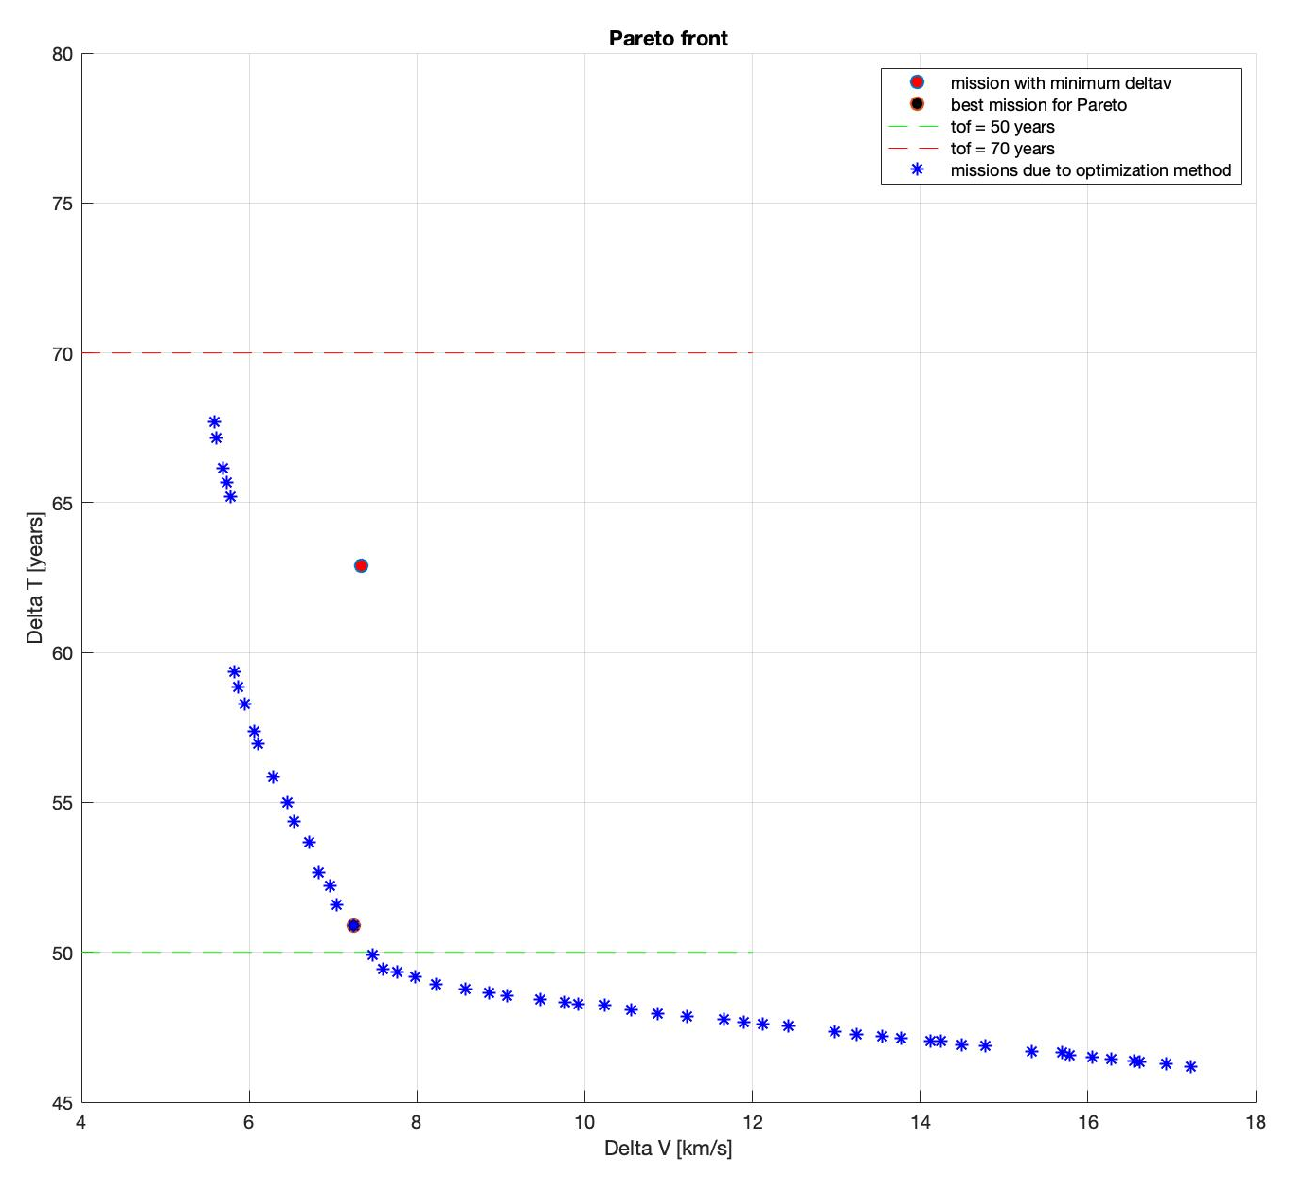
Interplanetary mission: Optimization
Method | Delta V [km/s]
Nested-loop (no time constraints) | 5.3652
Genetic algorithm | 7.3324
Pareto front | 7.2419

Slide 11
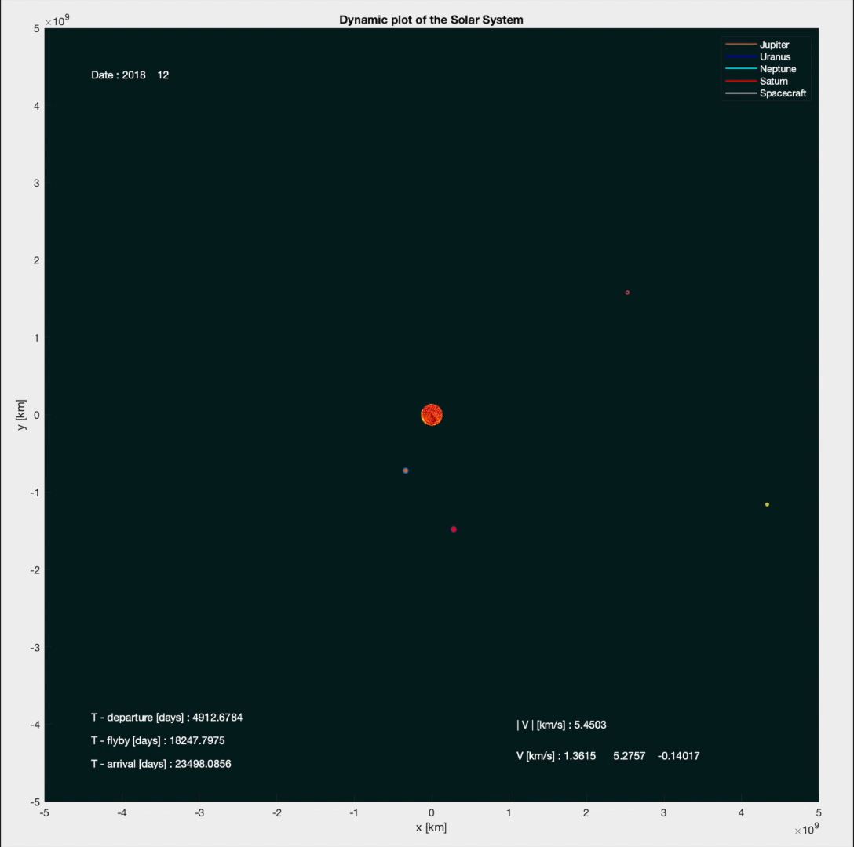
Interplanetary mission: Final results

Slide 12
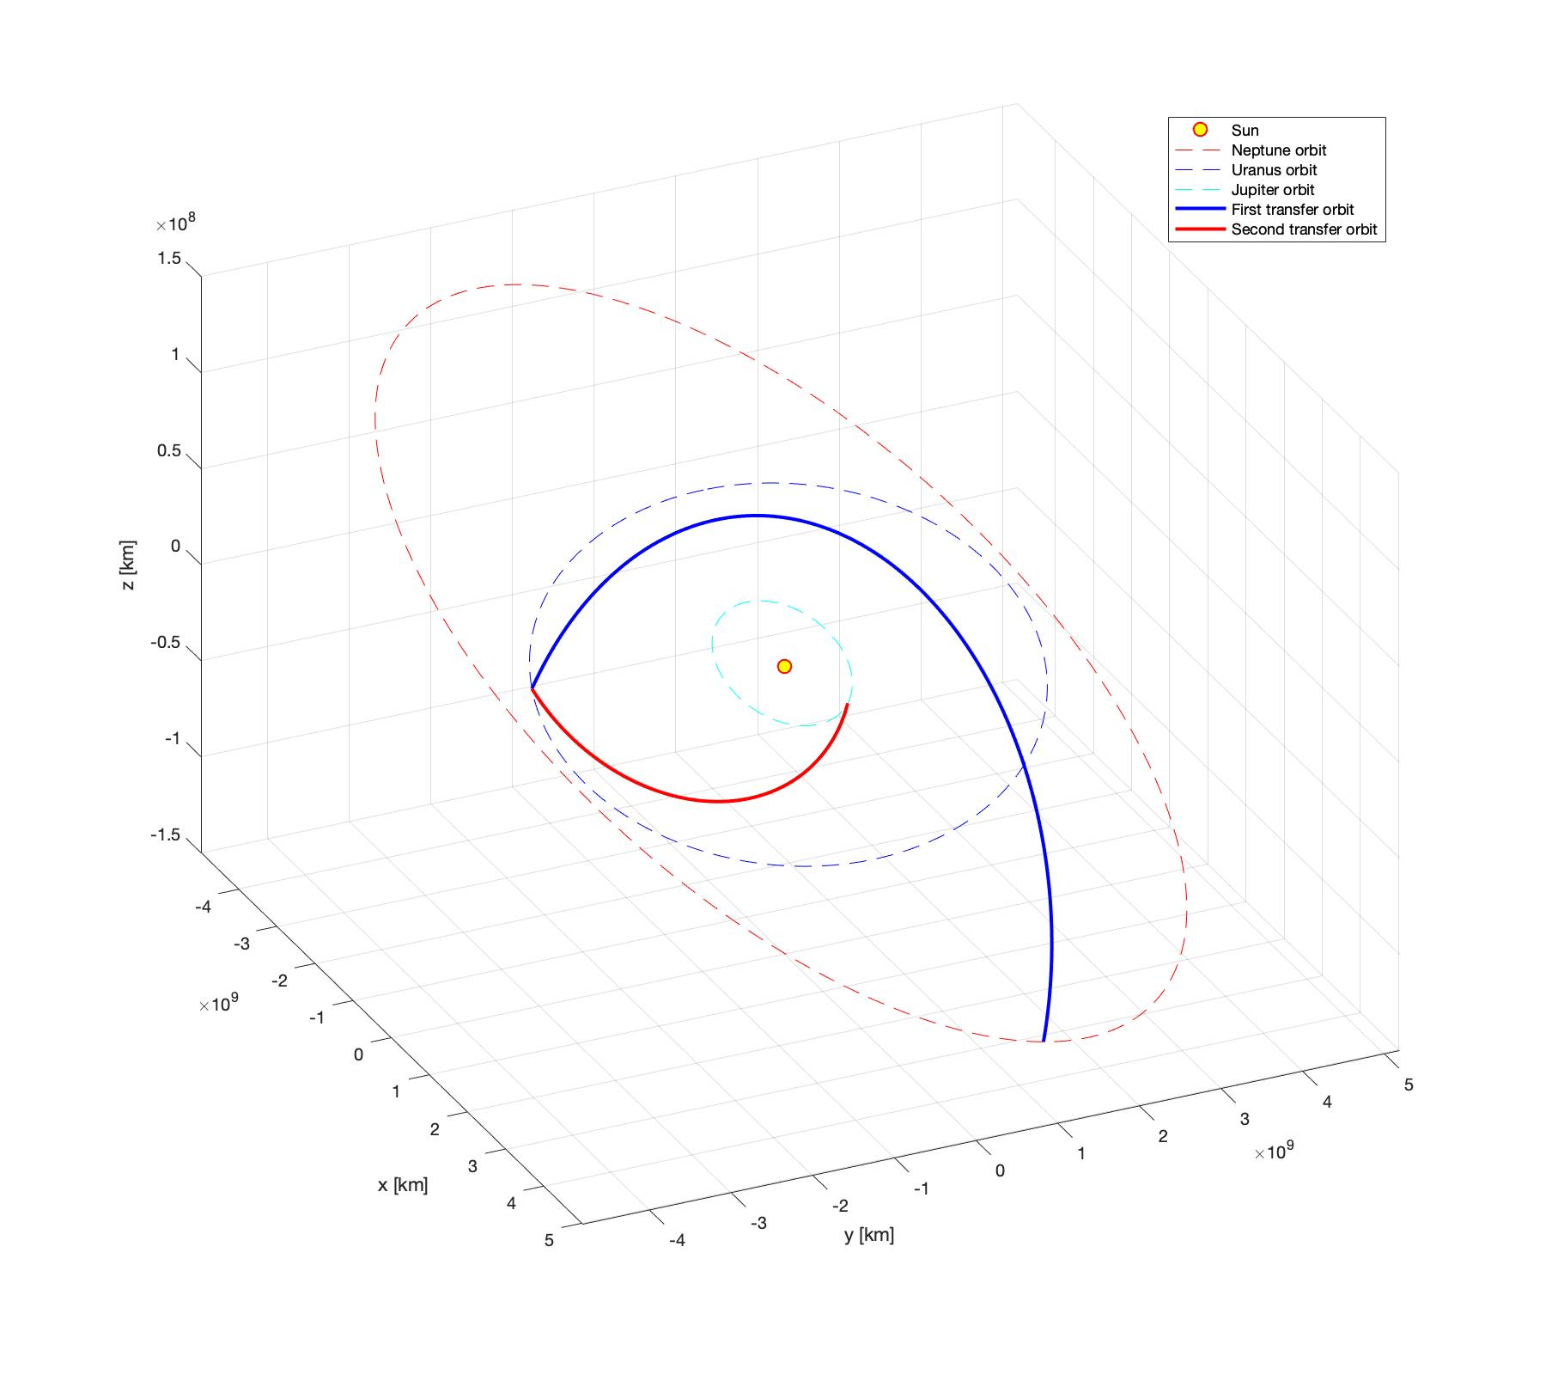
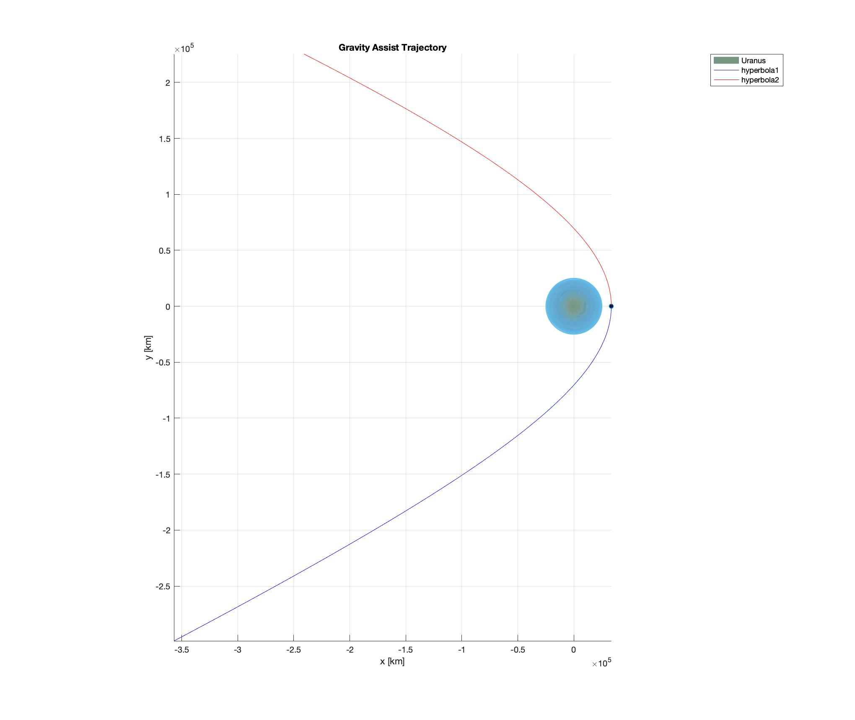
Interplanetary mission: Final results
Heliocentric transfer orbits
h_{P}=8044.4 km; ∆T_{H}=0.792 years

Slide 13
Interplanetary mission: Final results
Final results
Manoeuvre | Date | ∆V [km/s]
Departure | 01/01/2032 | 3.555
Flyby | 12/11/2067 | -0.12
Arrival | 01/06/2083 | 3.566
Total | 51.4145 years | 7.2419

Slide 14
Interplanetary mission: Conclusion and comments
Triple-loop
Pareto front

Slide 15
Assignment 2: Introduction
Assignment 2: Planetary Explorer Mission – Part 1
Introduction
Ground tracks

Slide 16
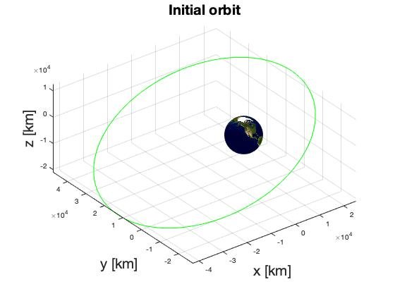
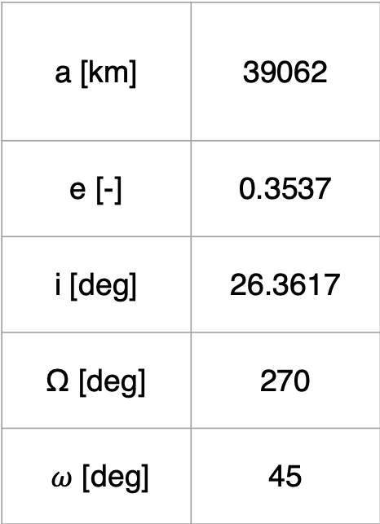
Planetary mission: Introduction
Perturbations → J₂ and SRP
Satellite orbit
a [km] | 39062
e [-] | 0.3537
i [deg] | 26.3617
Ω [deg] | 270
$ω$ [deg] | 45

Slide 17
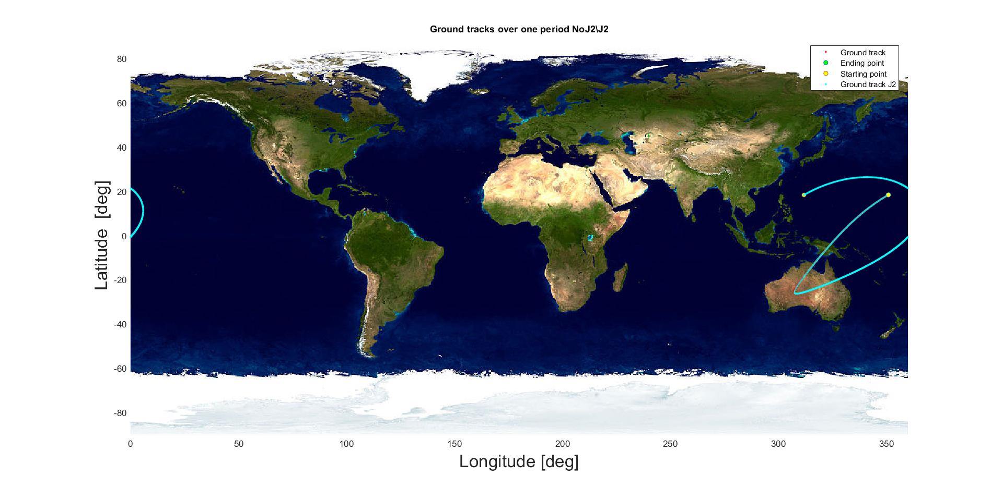
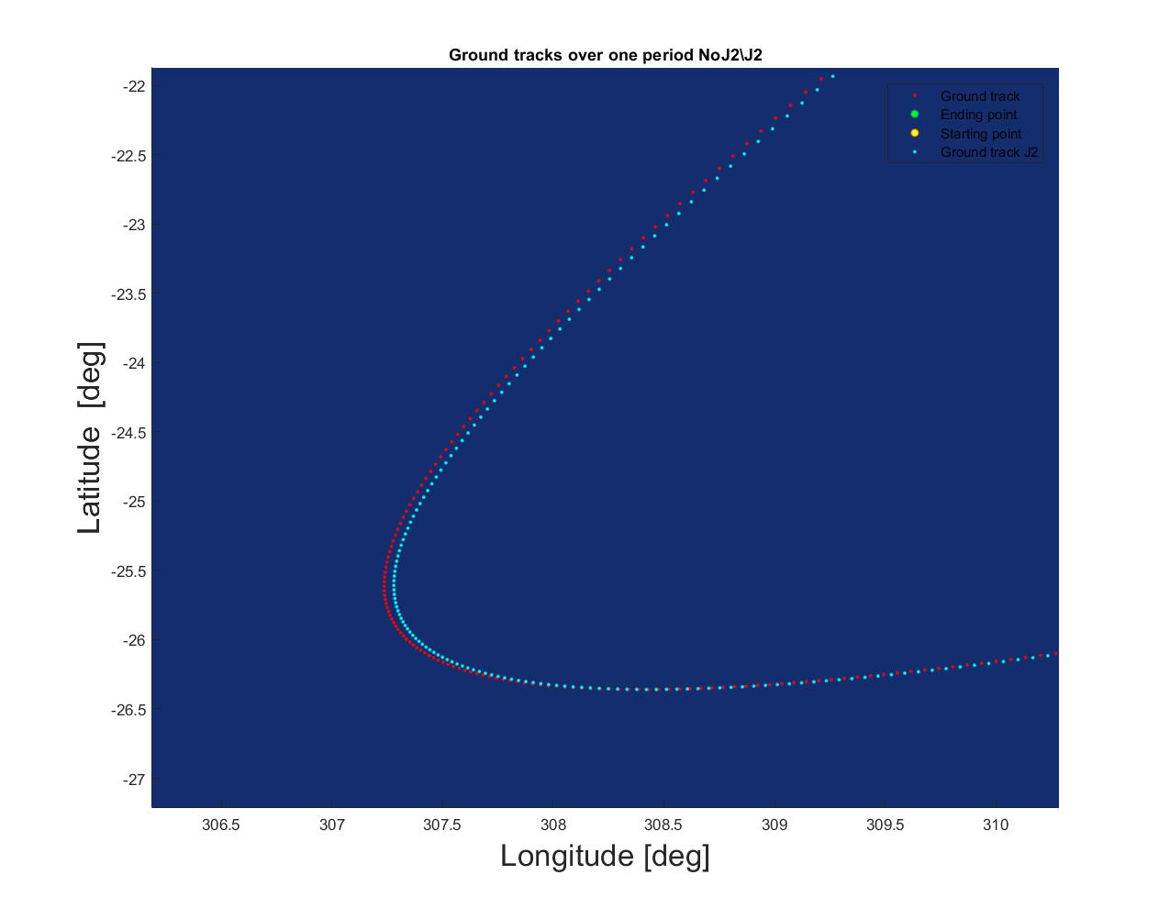
Planetary mission: Ground tracks
Ground track over one orbit period
Close-up

Slide 18

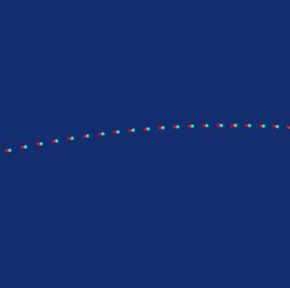
Planetary mission: Ground tracks
Ground tracks over one day
Close-up

Slide 19
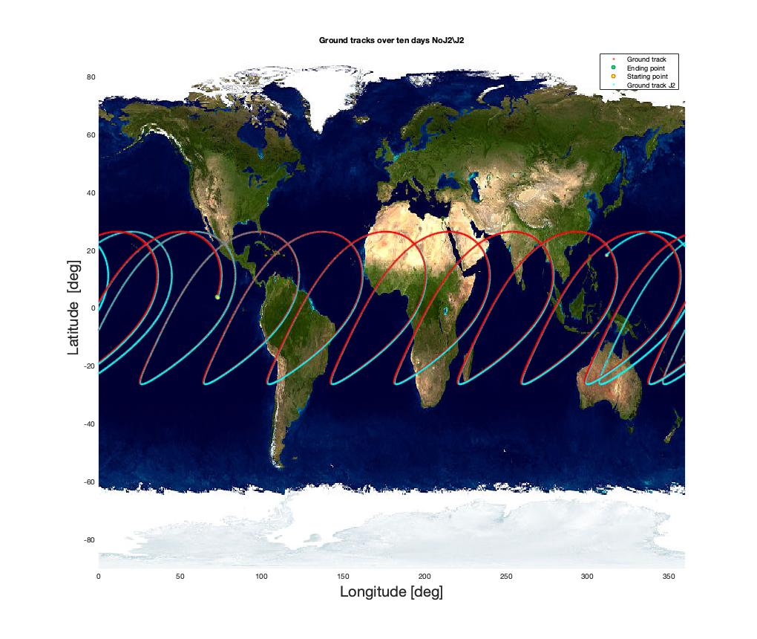
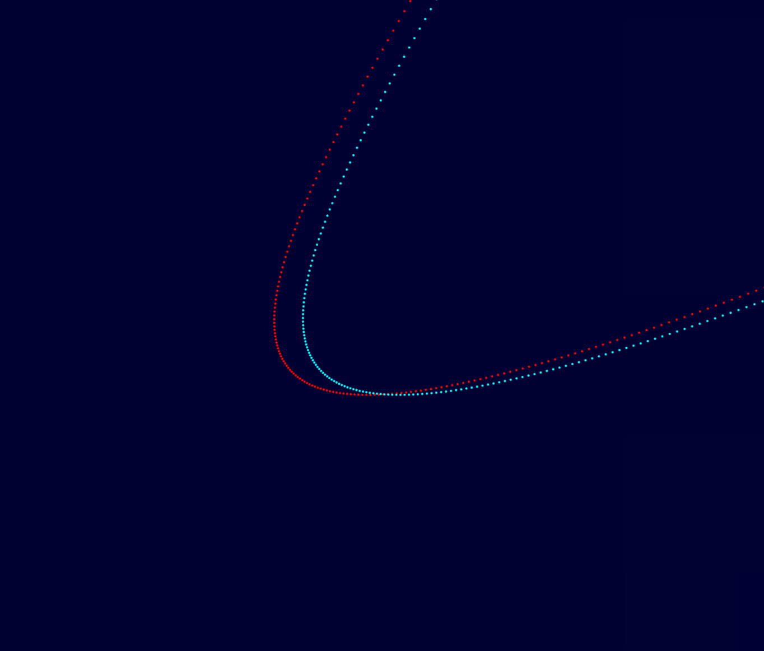
Planetary mission: Ground tracks
Ground tracks over ten days
Close-up

Slide 20
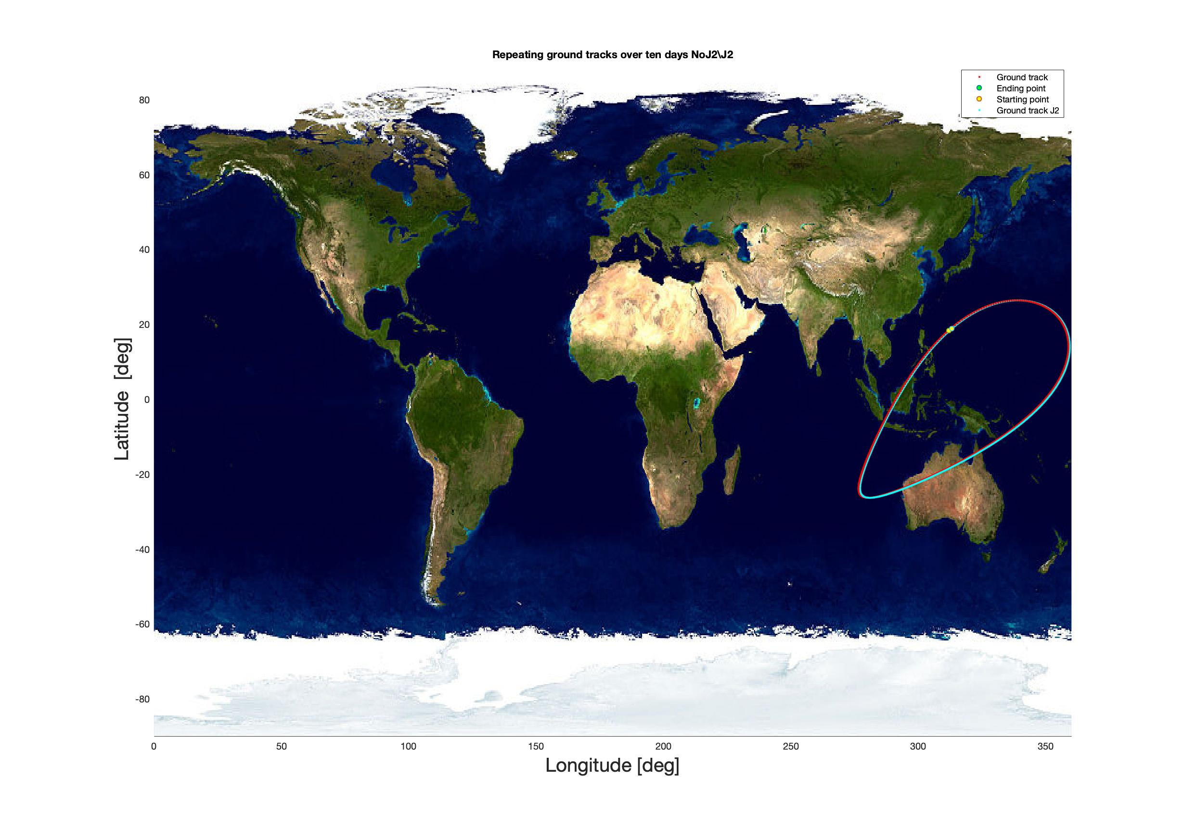
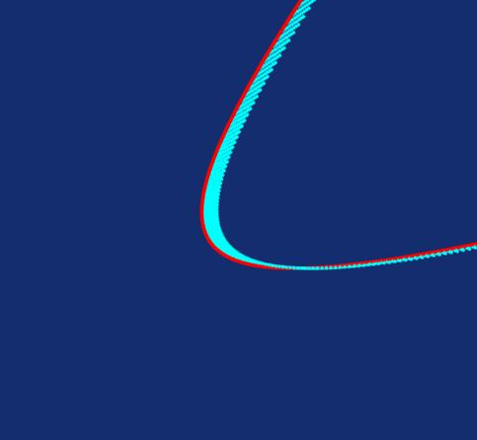
Planetary mission: Ground tracks
Repeated ground tracks over ten days
Close-up

Slide 21
Assignment 2: Introduction
Assignment 2: planetary explorer mission – Part 2
Earth’s shadow
Perturbations: J₂ and SRP
GOES-6 real data comparison

Slide 22
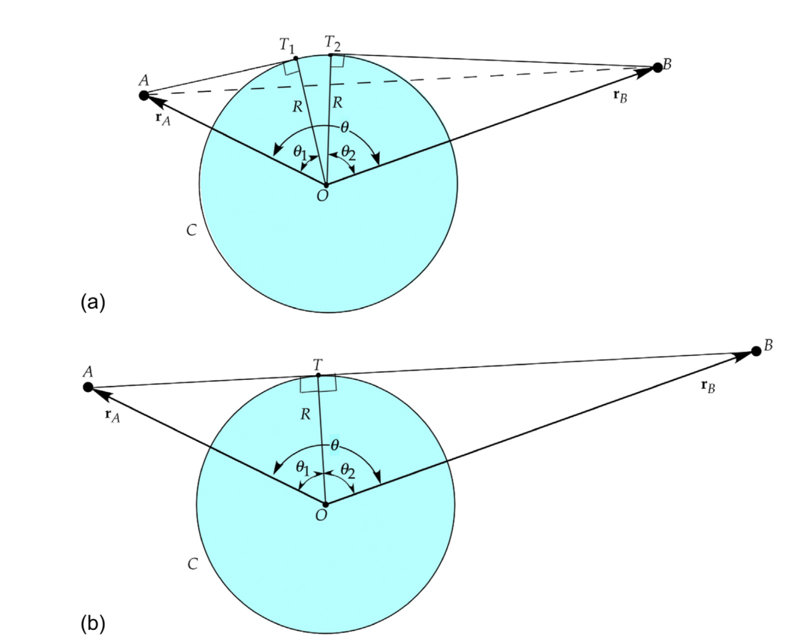
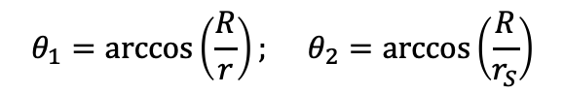
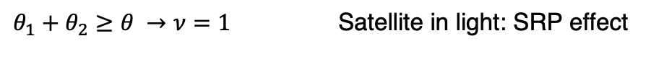
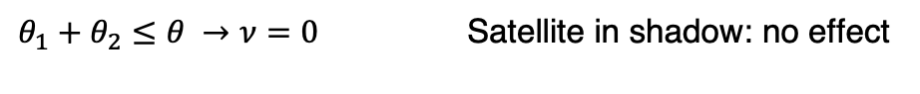
Assignment 2: Earth’s shadow
$$θ_{1}=\arccos\left(\frac{R}{r}\right); θ_{2}=\arccos\left(\frac{R}{r_{S}}\right)$$
$θ_{1}+θ_{2}≤θ →ν=0$ Satellite in shadow: no effect
$θ_{1}+θ_{2}≥θ →ν=1$ Satellite in light: SRP effect
Curtis H. – Orbital Mechanics For Engineering Students. Figure 12.15, pag.702

Slide 23
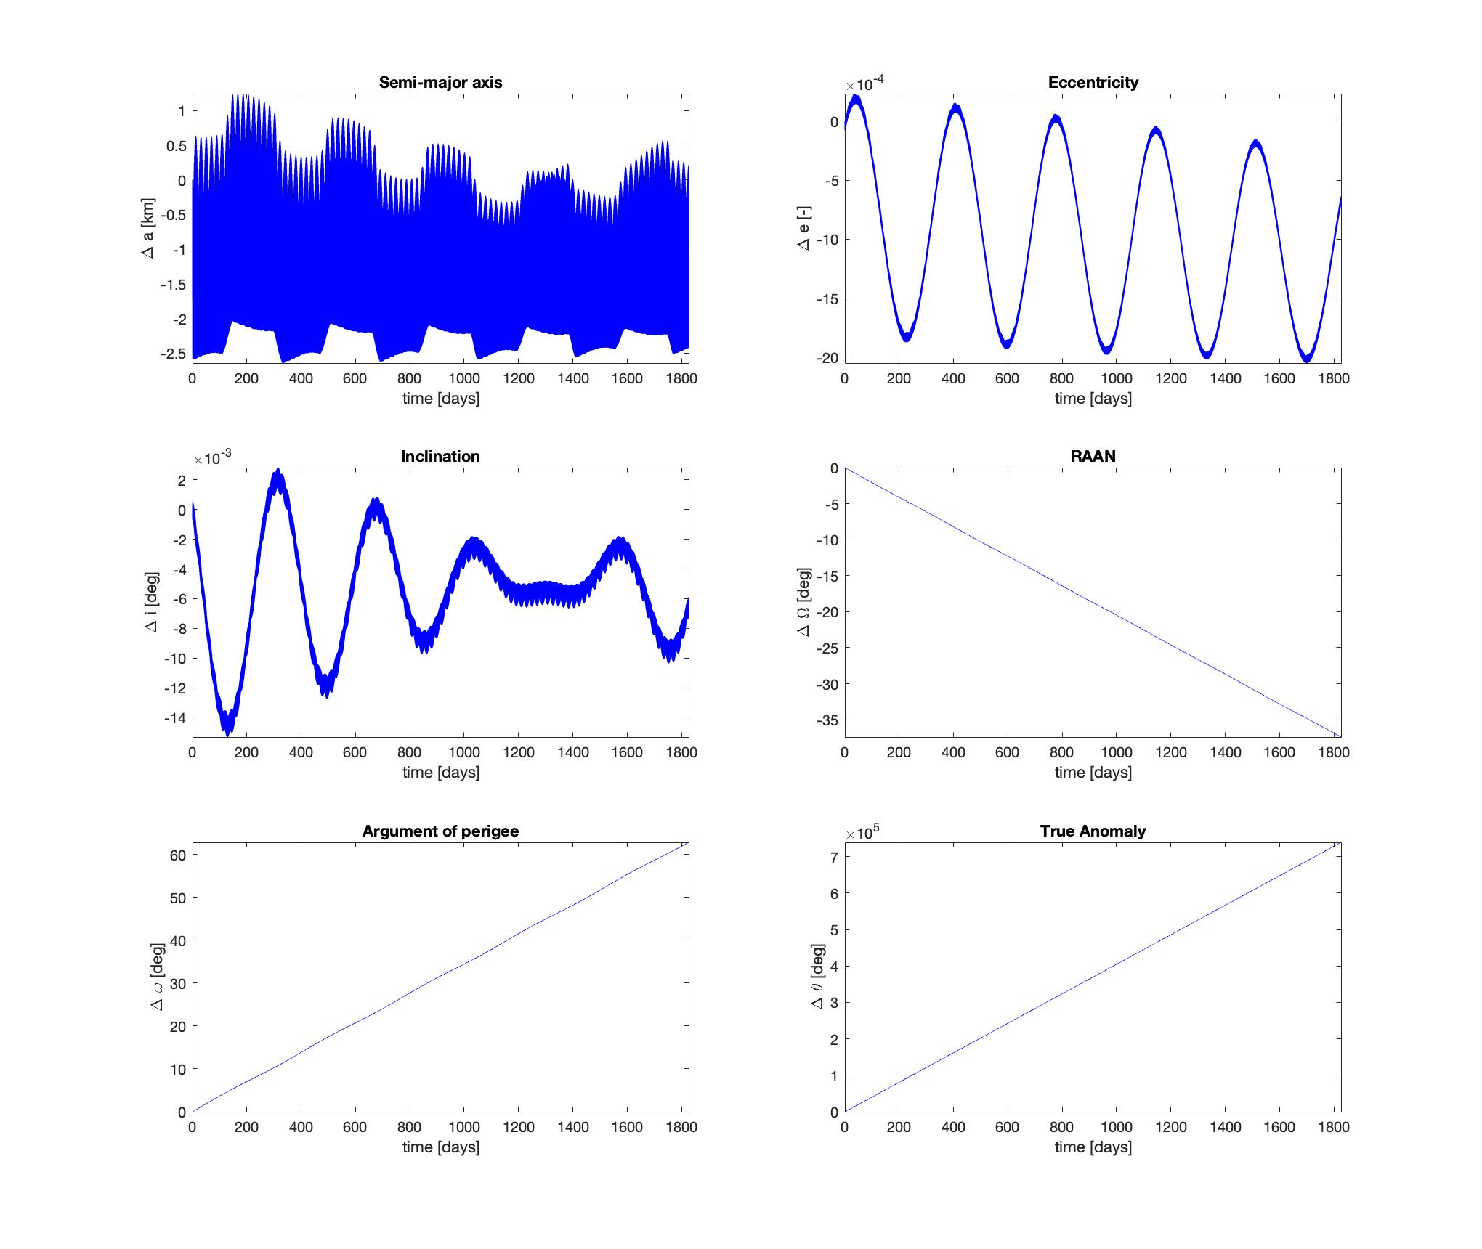
Planetary mission: Orbit perturbations
Orbital elements time evolution over five years

Slide 24
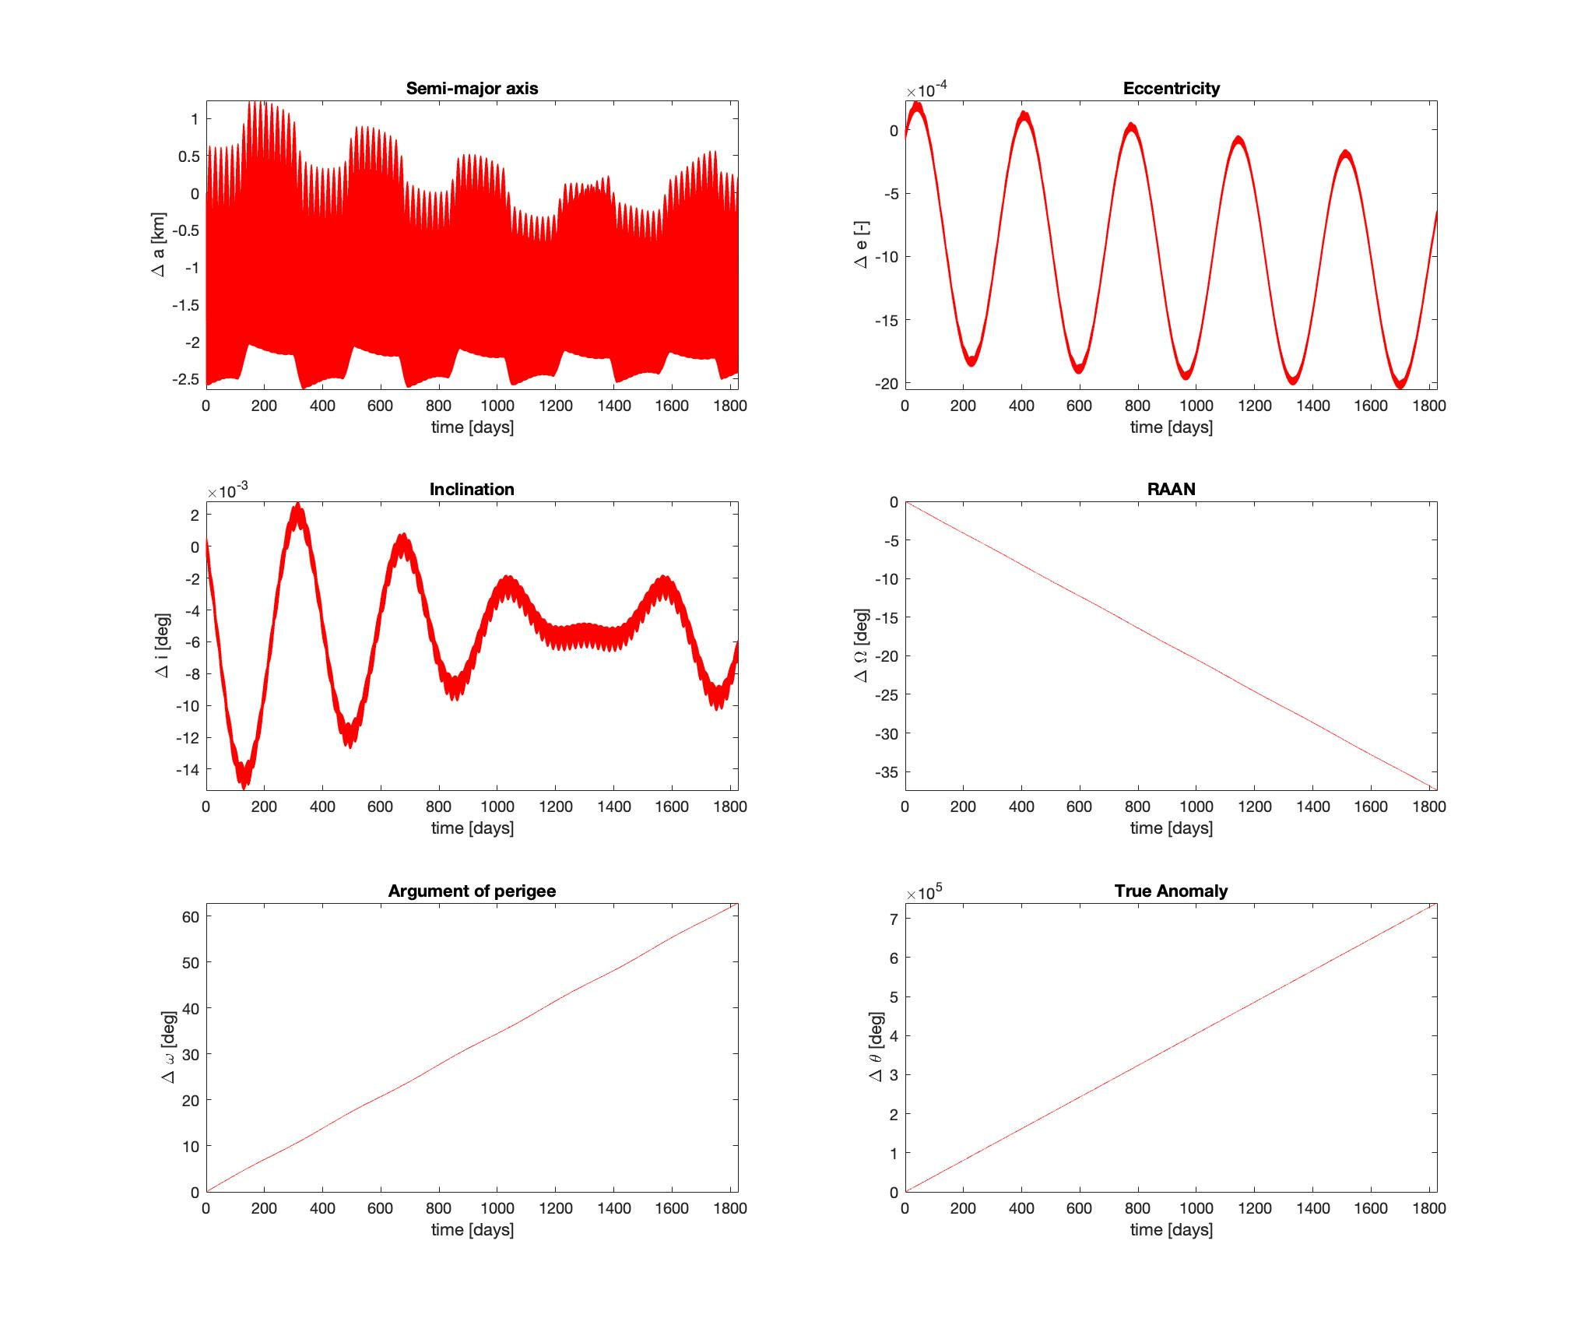
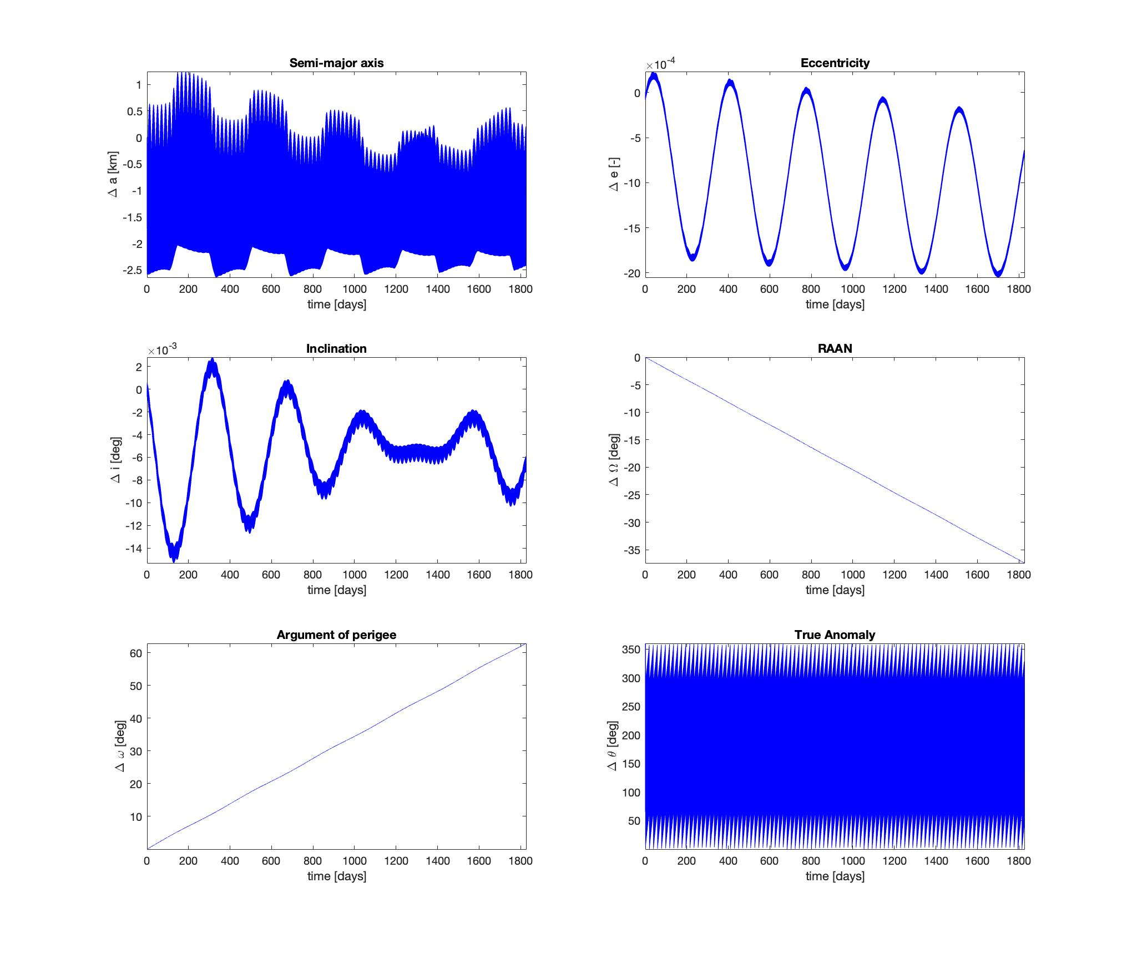
Planetary mission: Orbit perturbations
Gauss planetary equations solution
Computational time: 49.7256 s
(5 years time window with 22500 points)
Perturbed two body equations solution (Cowell)
Computational time: 74.2545 s
(5 years time window with 22500 points)

Slide 25
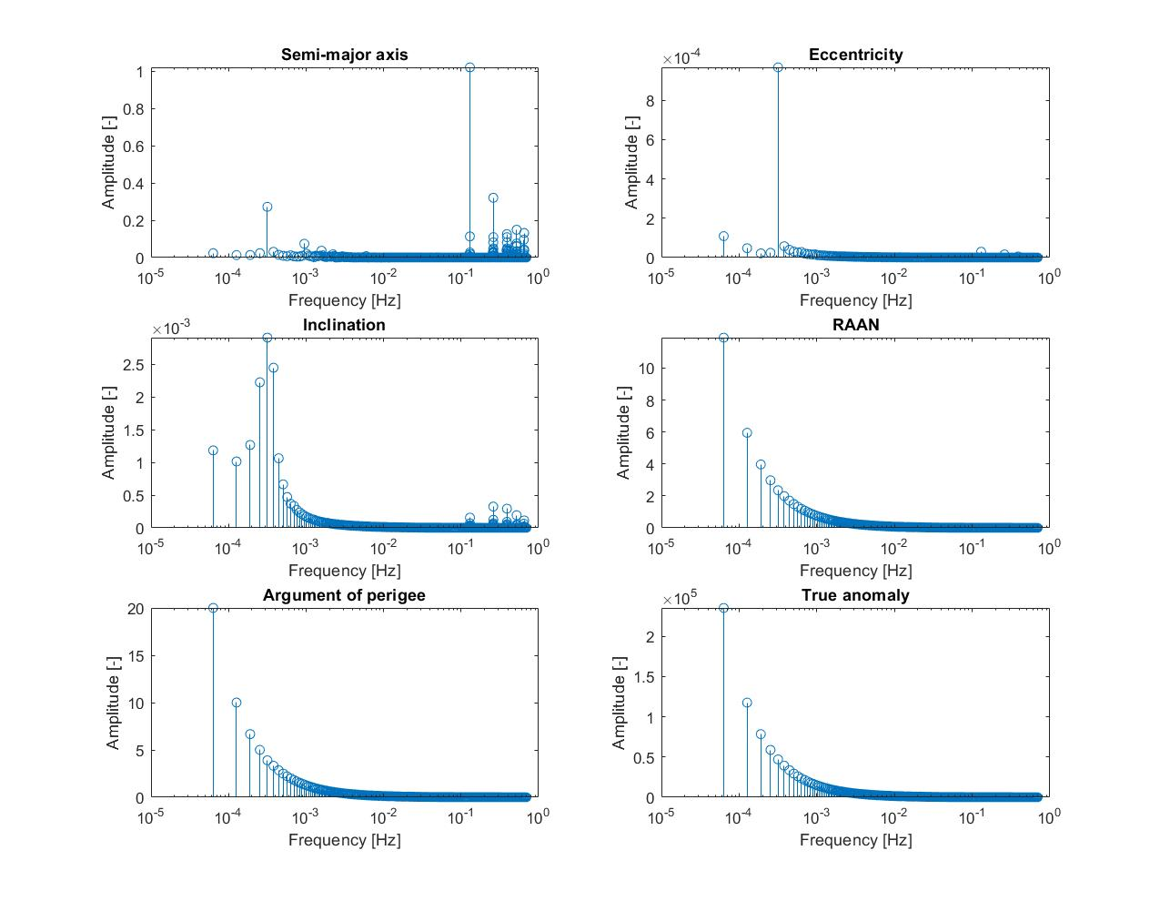
Planetary mission: Orbit perturbations
Spectral analysis through Fourier transform
N.B. Time domain is discretised in 22500 points (each interval is equal to 7013 s), therefore Hz=1/7013 s.

Slide 26
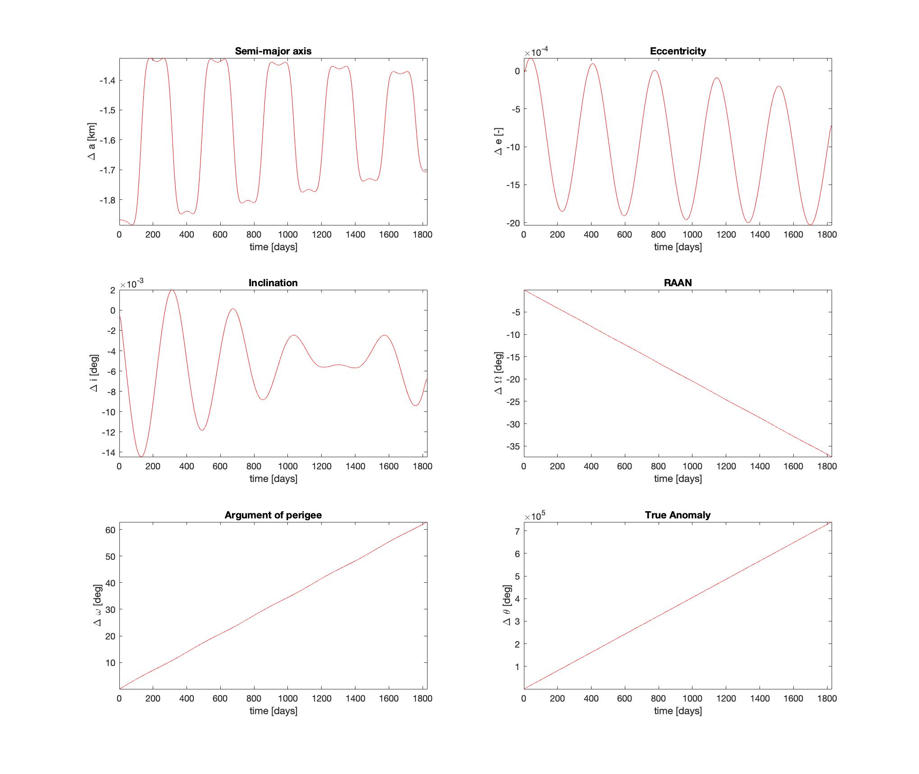
Planetary mission: Orbit perturbations
Filtering elements variations to cut off short period effects

Slide 27

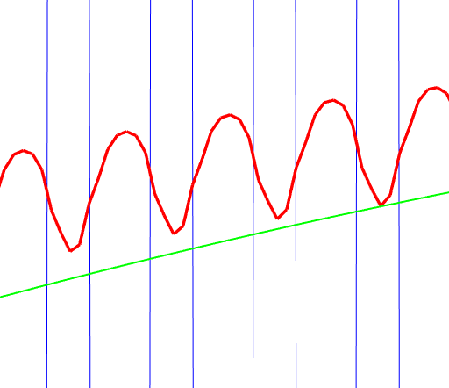
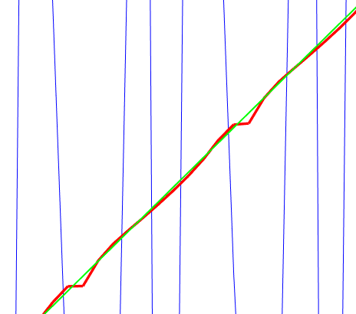
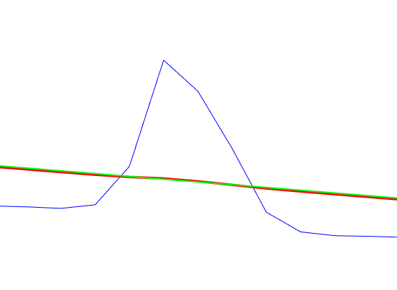
Planetary mission: Orbit perturbations
Unfiltered, ‘movmean’ filtered, ‘smoothn’ filtered comparison

Slide 28
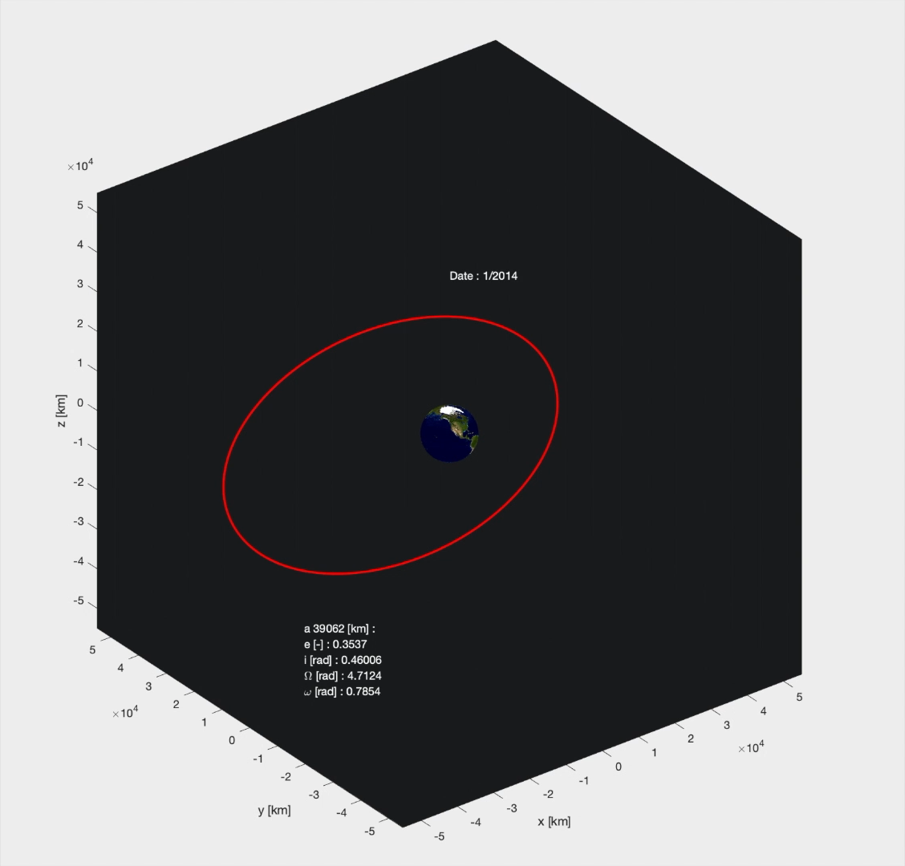
Planetary mission: Orbit perturbations
Orbit evolution: 2014 → 2054

Slide 29
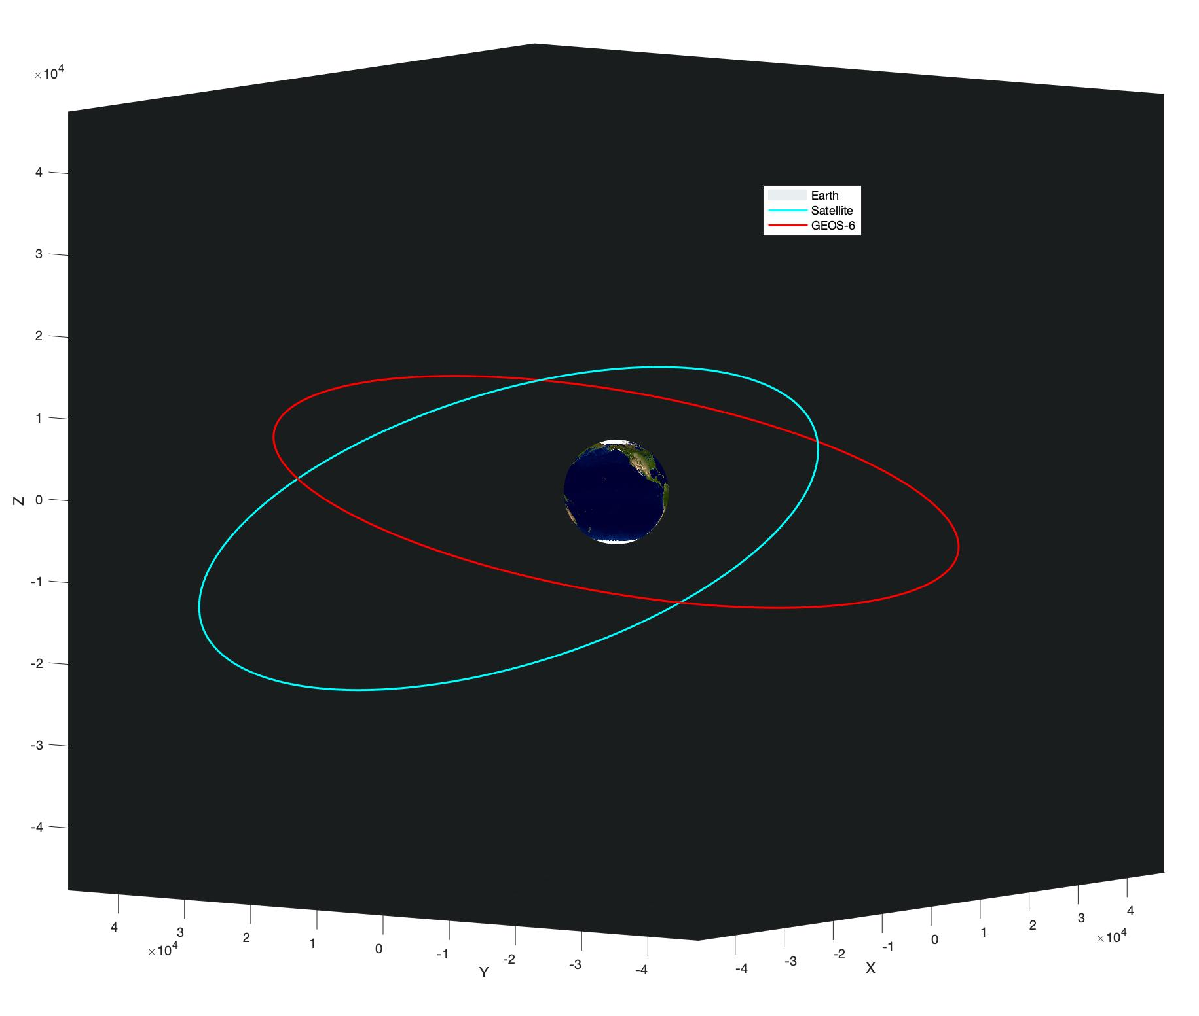
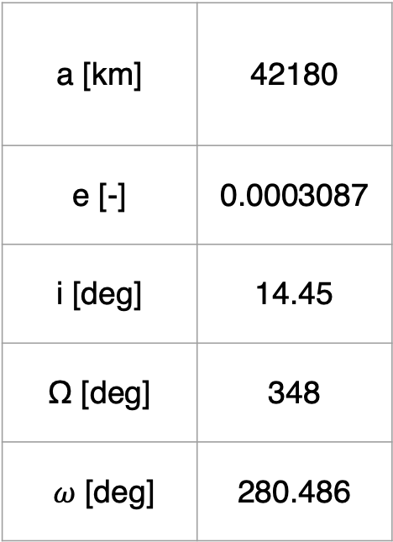
Planetary mission: Real data comparison
GOES-6 satellite orbit @ 01/01/2018
a [km] | 42180
e [-] | 0.0003087
i [deg] | 14.45
Ω [deg] | 348
$ω$ [deg] | 280.486

Slide 30
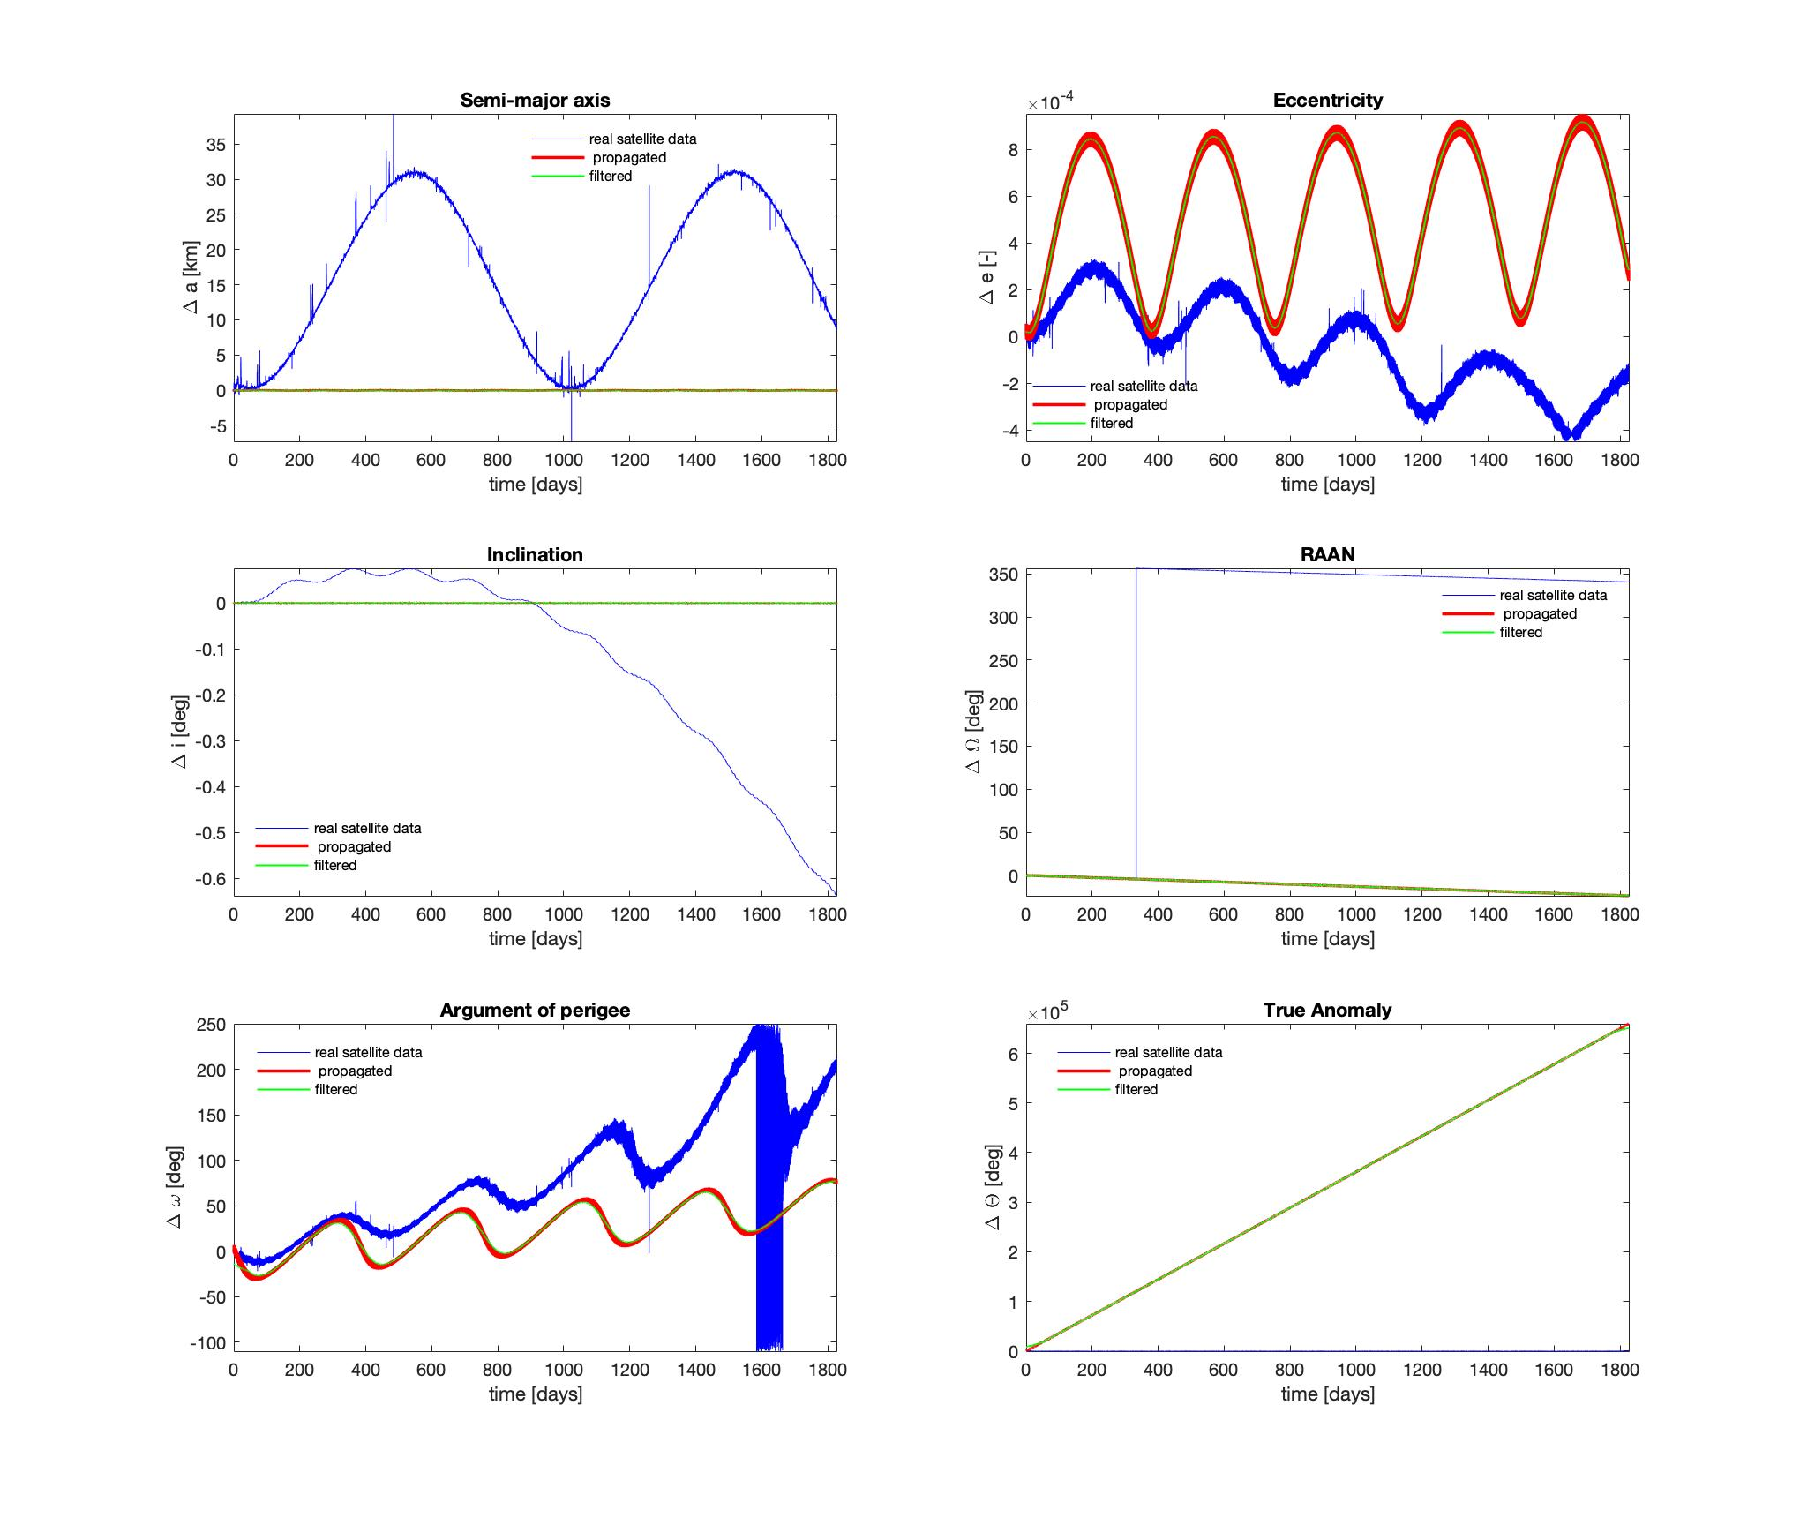
Planetary mission: Real data comparison
2014-2019 real data – SRP+J₂ propagation comparison

Slide 31
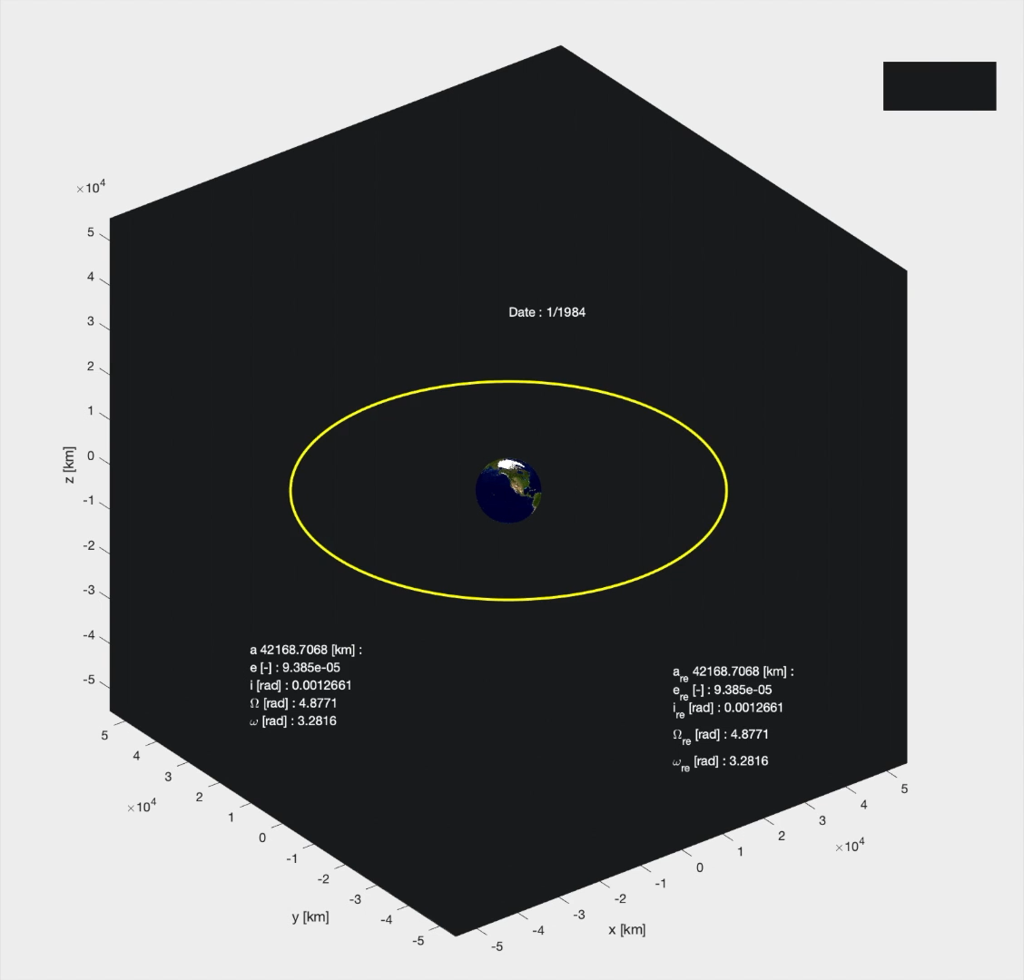
Planetary mission: Real data comparison
GEOS-6 orbit evolution comparison: 1984 → 2019

Slide 32
QUESTIONS
Thank you for your attention.
Any questions?

